Slide 1
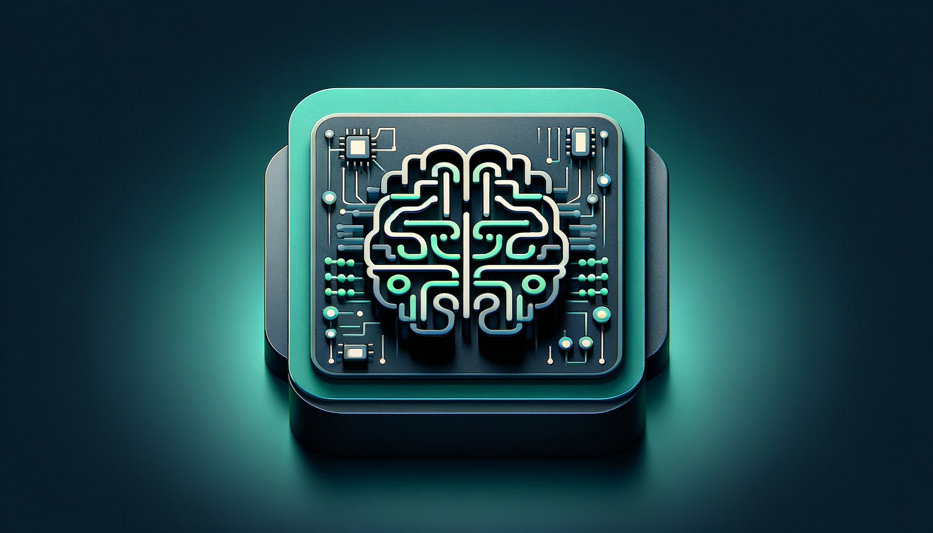
Tutorial 6
﻿CS5486 Intelligent Systems:
Modern Machine Learning: From Dimensionality Reduction to Generative AI
Hongzong Li
Department of Computer Science City University of Hong Kong

Slide 2
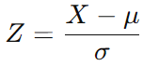
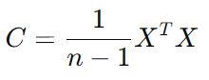
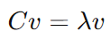
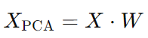
Unsupervised Machine Learning
Generally, the more information they have about a particular problem, the better. However, that could also lead to slow training times and performance. Dimensionality reduction techniques help reduce the number of features present within a dataset without sacrificing predictive value. Unsupervised algorithms are also used to reduce the dimensions in a dataset (i.e., the number of features. These algorithms are often used as an intermediary step in training a supervised learning algorithm.
Principal Component Analysis (PCA)
Standardize the data.
Compute the covariance matrix of the standardized data.
Compute the eigenvalues and eigenvectors of the covariance matrix.
Sort the eigenvectors by eigenvalues in descending order.
Select the top k eigenvectors to form the projection matrix.
Project the data onto the top k components to obtain the reduced data.

Slide 3

Unsupervised Machine Learning
Principal Component Analysis (PCA)

Slide 4
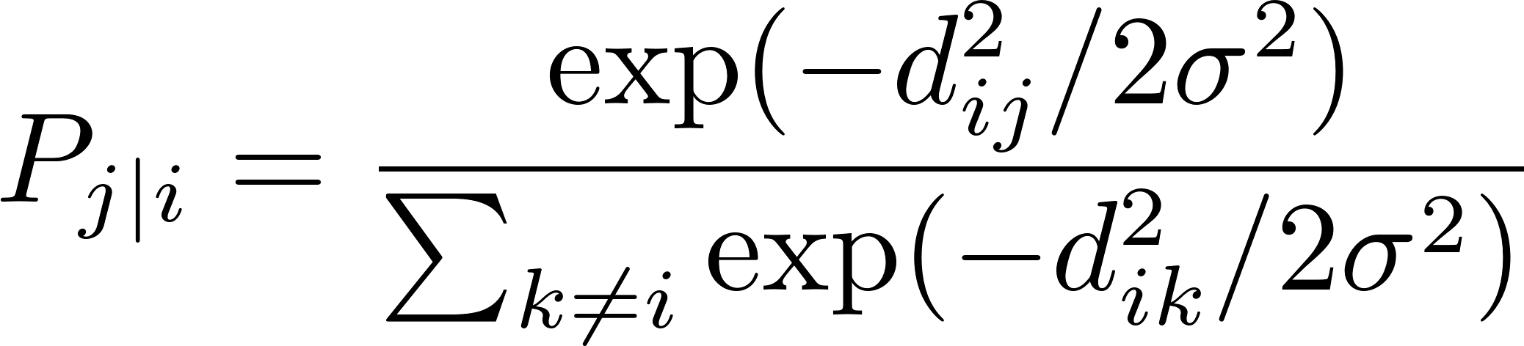
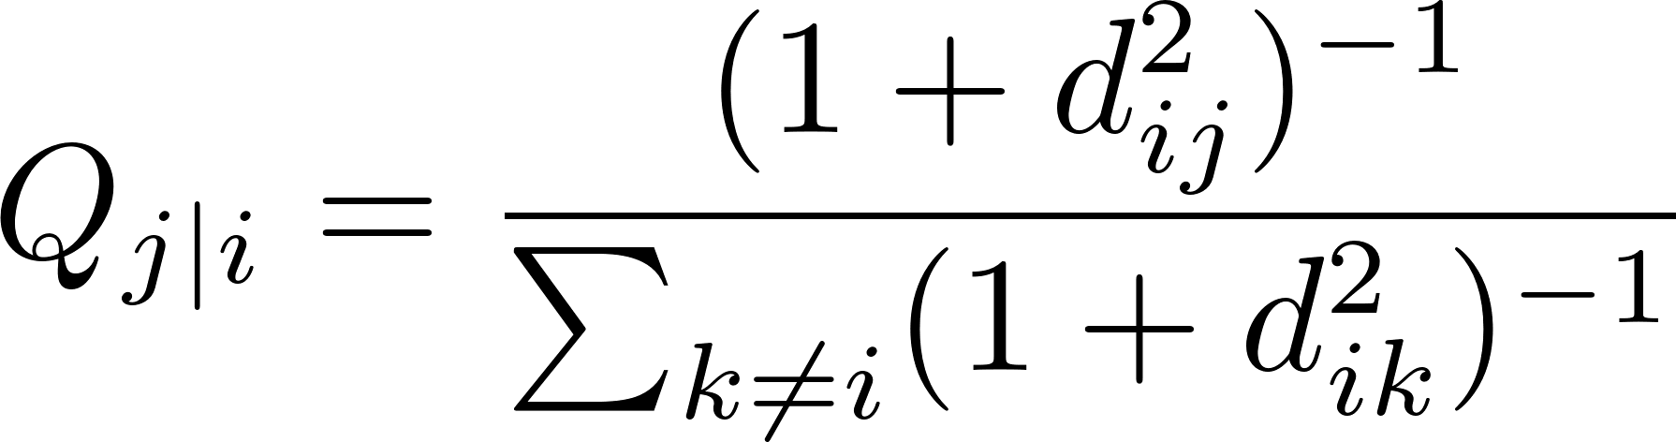
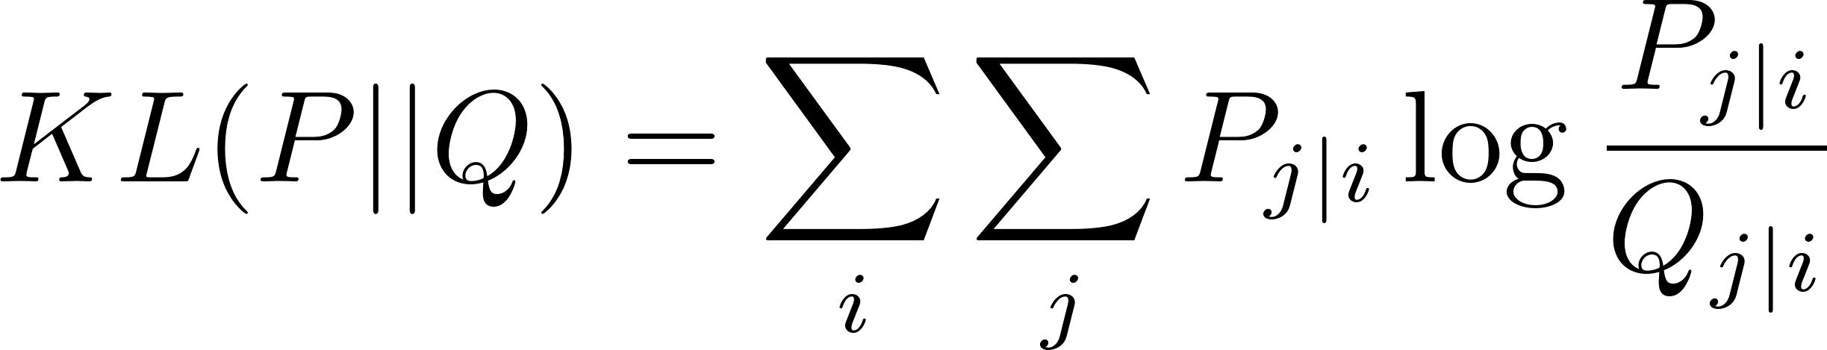
Unsupervised Machine Learning
PCA: preserving global structures, t-SNE: preserving local similarities between points
t-Distributed Stochastic Neighbor Embedding (t-SNE)
A non-linear dimensionality reduction technique used primarily for data visualization. It is widely used to project high-dimensional data (e.g., images, word embeddings, or genetic data) into 2D or 3D space for visualization.
Step 1: Compute Pairwise Similarities in High-Dimensional Space
The probability that a point j is a neighbor of i:
Step 2: Compute Similarities in Lower-Dimensional Space
Step 3: Minimize the KL Divergence
Gradient Descent Optimization

Slide 5
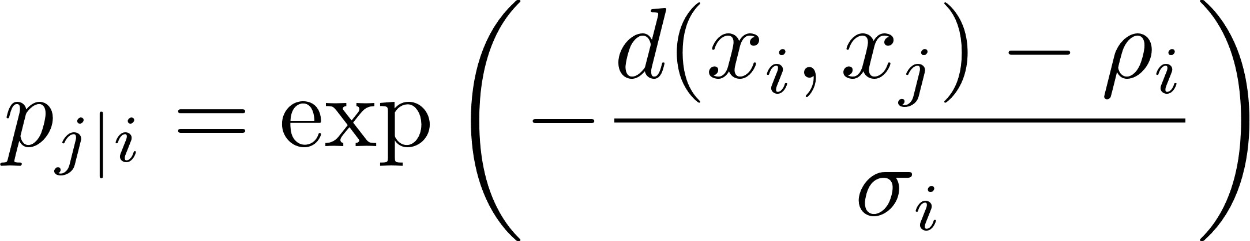
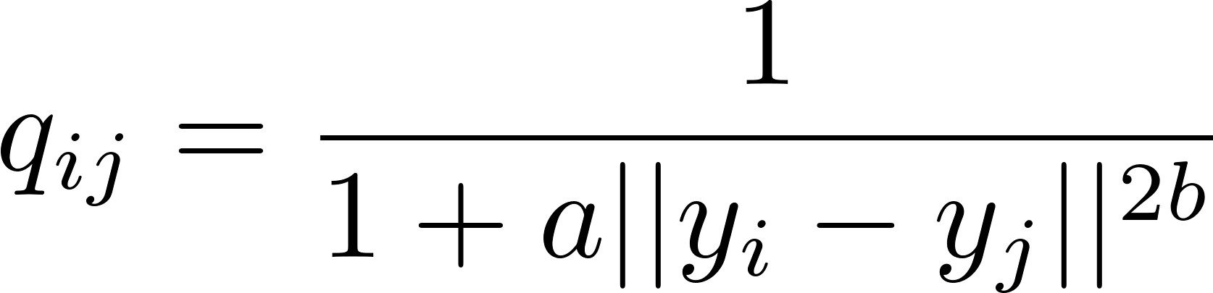
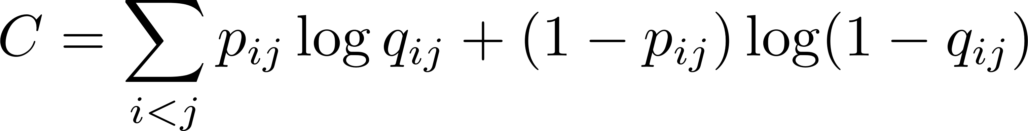
Unsupervised Machine Learning
UMAP: maintaining both local and global structure
Uniform Manifold Approximation and Projection (UMAP)
It is based on manifold learning, assuming that high-dimensional data lies on a lower-dimensional manifold.
Step 1: Construct a Weighted Graph of Data Points
Constructs a nearest neighbor graph of the high-dimensional data, estimating the probability that two points are connected based on a fuzzy set representation.
Step 2: Optimize the Graph in Lower-Dimensional Space
Step 3: Minimize the Cross-Entropy Loss
Uses Stochastic Gradient Descent (SGD)
If two points should be close in high-dimensional space (p_{ij} is large), they are pulled together.
If two points should be far apart (p_{ij} is small), they are pushed apart.
Notes:
\( d(x_i, x_j) \) is the distance between points \( x_i \) and \( x_j \).
\( \rho_i \) is the local connectivity parameter (ensuring uniform local density).
\( \sigma_i \) is the local scaling factor, controlling neighborhood size. yi​,yj​ are the low-dimensional coordinates.
a,b are hyperparameters that control the shape of the embedding (empirically determined by fitting to the high-dimensional data).

Slide 6
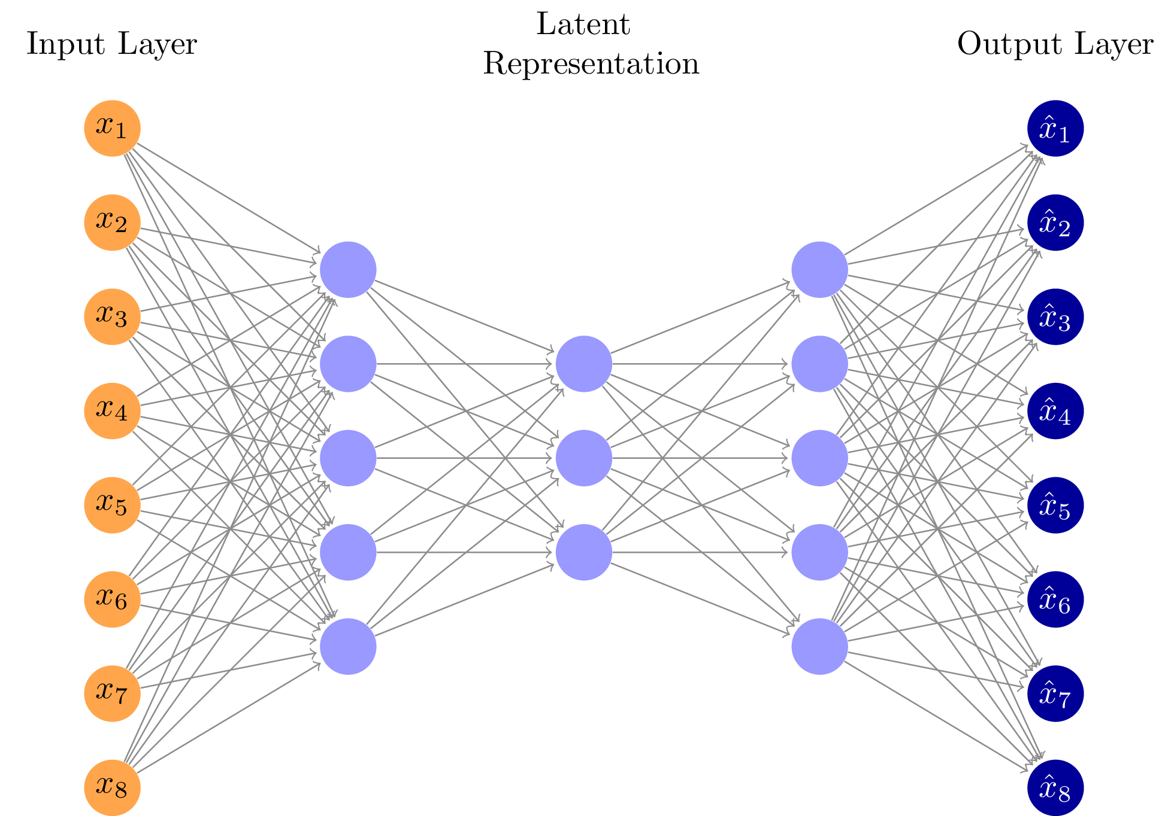
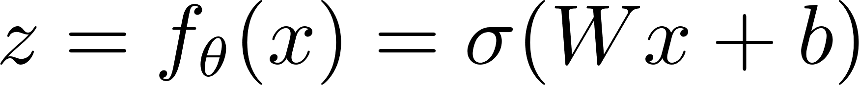
Unsupervised Machine Learning
Autoencoder is a type of neural network used for unsupervised learning that learns to compress (encode) and reconstruct (decode) input data.
encode input data into a compressed latent representation and then reconstructs the original input from this compressed space.
Main Components of an Autoencoder:
Encoder:
Maps input data to a lower-dimensional latent representation.
Typically consists of fully connected layers or convolutional layers

Slide 7
Unsupervised Machine Learning
Autoencoder
Main Components of an Autoencoder:
2. Latent Space (Bottleneck Layer):
The compressed representation of the input.
Captures the most important features while discarding noise/redundant information.

Slide 8
Unsupervised Machine Learning
Autoencoder
Main Components of an Autoencoder:
3. Decoder
Reconstructs the input data from the latent representation.
Tries to make the reconstructed output as similar to the input as possible.

Slide 9
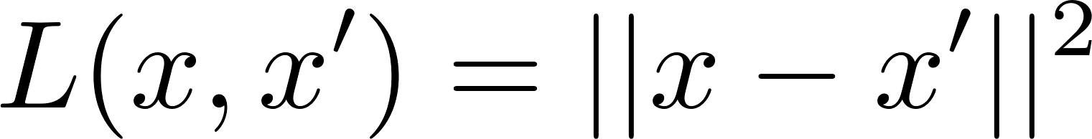
Unsupervised Machine Learning
Autoencoder
Loss function
The autoencoder is trained to minimize the reconstruction loss, usually Mean Squared Error (MSE) or Binary Cross Entropy (BCE):
MSE:
BCE:

Slide 10

Reinforcement Learning
Reinforcement learning is a subset of machine learning algorithms that utilize rewards to promote a desired behavior or prediction and a penalty otherwise.
Agent: The decision-maker (e.g., a robot, a self-driving car, a game-playing AI).
Environment: The world in which the agent operates.
Actions (A): The set of possible moves the agent can take.
State (S): The current situation of the agent in the environment.
Reward (R): The feedback the agent receives after taking an action.

Slide 11
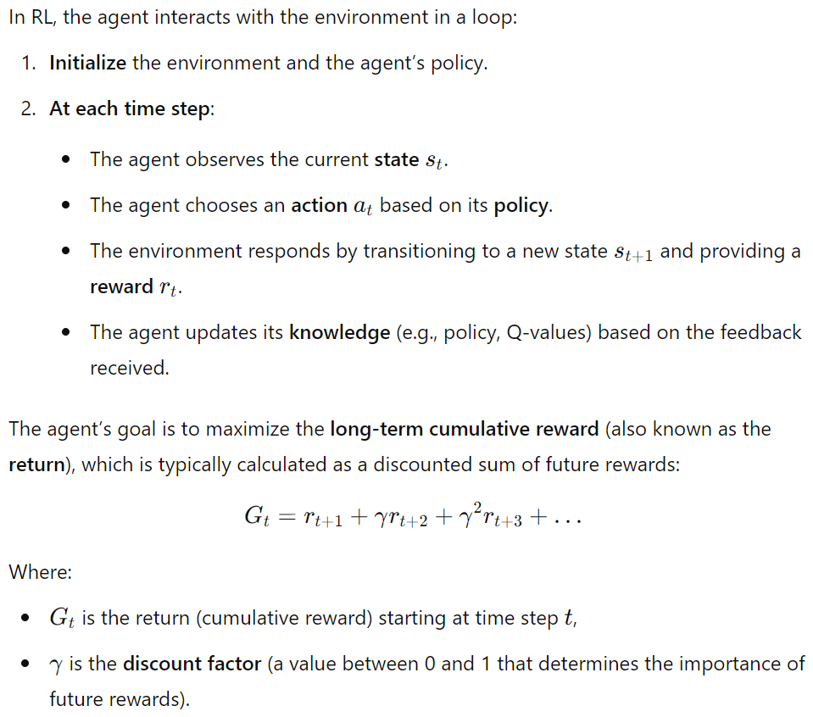
Reinforcement Learning
The Reinforcement Learning Process

Slide 12
Reinforcement Learning
Value-based → Focuses on estimating the value function and selecting actions based on it.
E.g., Q-learning, Deep Q-Network
Policy-based → Directly learns the policy function that maps states to actions.
E.g., Policy Gradient, PPO, TRPO

Slide 13
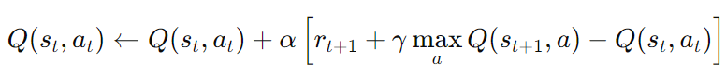
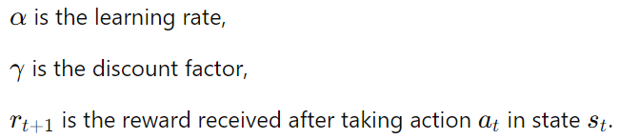
Reinforcement Learning
Value-based
Q-Learning
A model-free RL algorithm that learns the value of each state-action pair. The agent updates a table of Q-values, which estimates the expected future reward for each action taken in each state.
The update rule is:
Deep Q-Network (DQN): version of Q-learning that uses a neural network to approximate the Q-values. This approach is useful for handling high-dimensional state spaces, such as images.

Slide 14
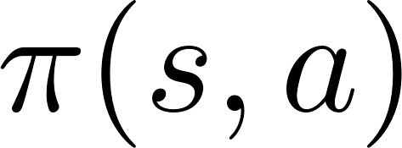
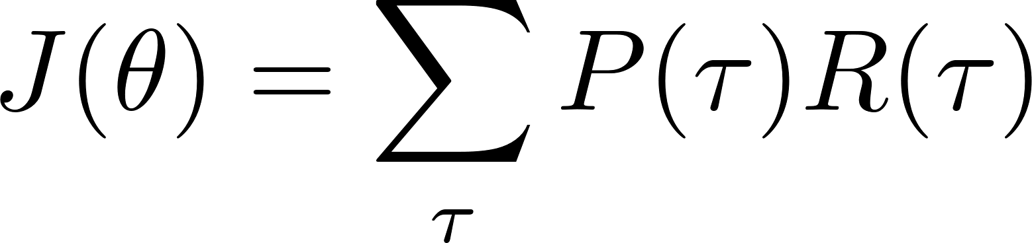
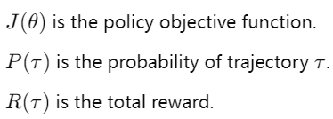
Reinforcement Learning
Policy-based
Policy Gradient (PG)
Unlike DQN, which learns a value function, Policy Gradient (PG) directly learns the policy
Instead of estimating Q-values, PG optimizes the probability of choosing the best action using gradient ascent:
How It Works
episodes
collects experience
adjusts the policy parameters θ
increase the probability of actions that led to higher rewards
stochastic gradient ascent

Slide 15
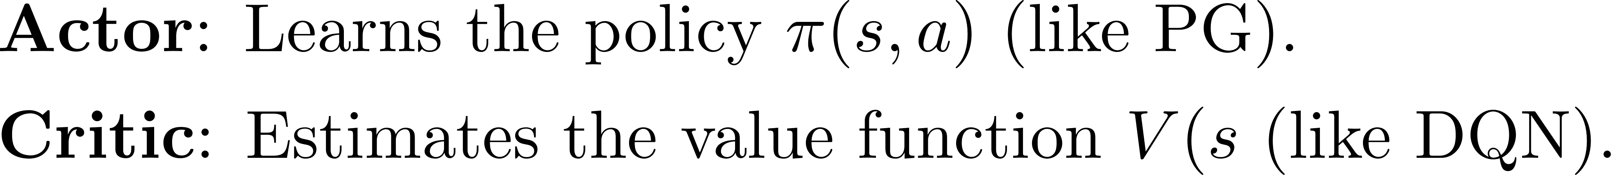
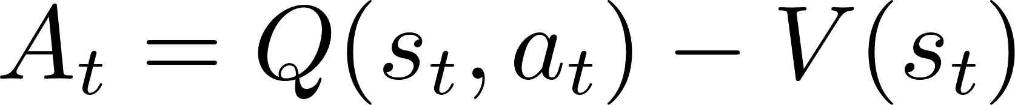
Reinforcement Learning
Combine value-based and policy-based
Actor-Critic
Computes an advantage function to determine how much better an action is compared to the expected value:
Uses gradient updates for both policy (Actor) and value function (Critic).

Slide 16
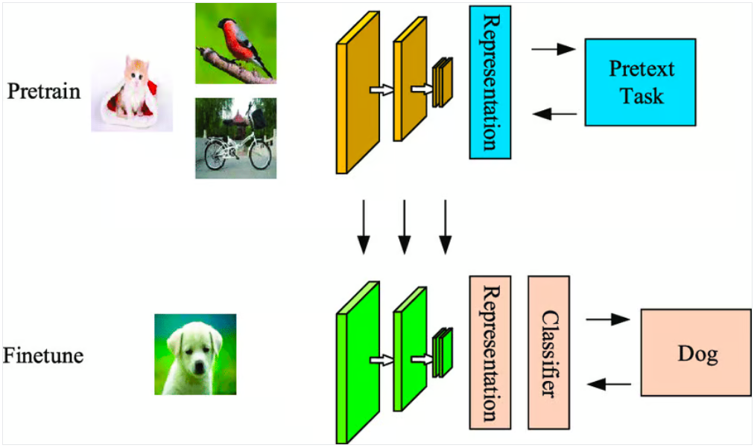
Self-Supervised Learning
Self-supervised learning (SSL) is a type of unsupervised learning where the model generates pseudo-labels or auxiliary tasks from the input data itself, without needing explicit labels. This enables the model to learn useful representations from unlabeled data. These representations can then be used for downstream tasks like classification, regression, or even reinforcement learning.

Slide 17
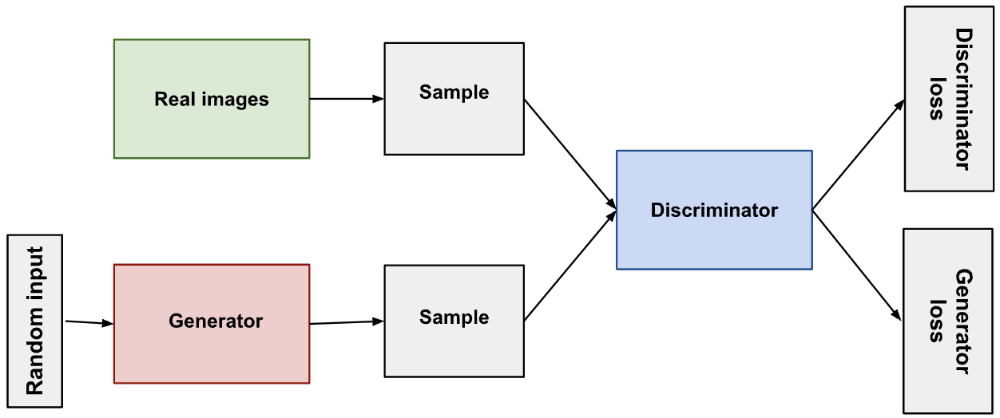
Self-Supervised Learning
GAN
Generative Adversarial Networks (GANs) are a class of deep learning models that consist of two neural networks, a generator and a discriminator, which are trained together in a competitive manner.
The generator learns to generate plausible data. The generated instances become negative training examples for the discriminator.
The discriminator learns to distinguish the generator's fake data from real data. The discriminator penalizes the generator for producing implausible results.

Slide 18
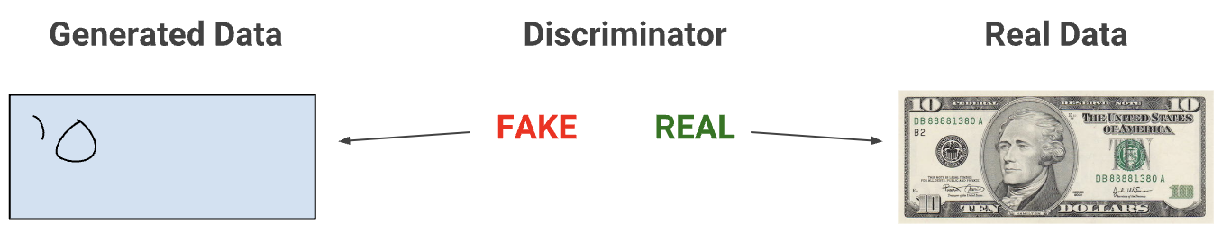
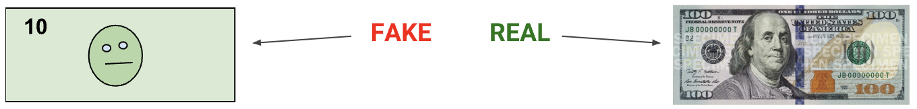
Self-Supervised Learning
GAN
When training begins, the generator produces obviously fake data, and the discriminator quickly learns to tell that it's fake:
As training progresses, the generator gets closer to producing output that can fool the discriminator:

Slide 19
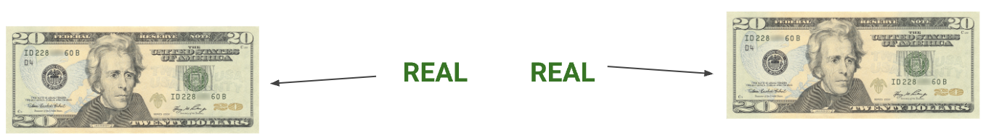
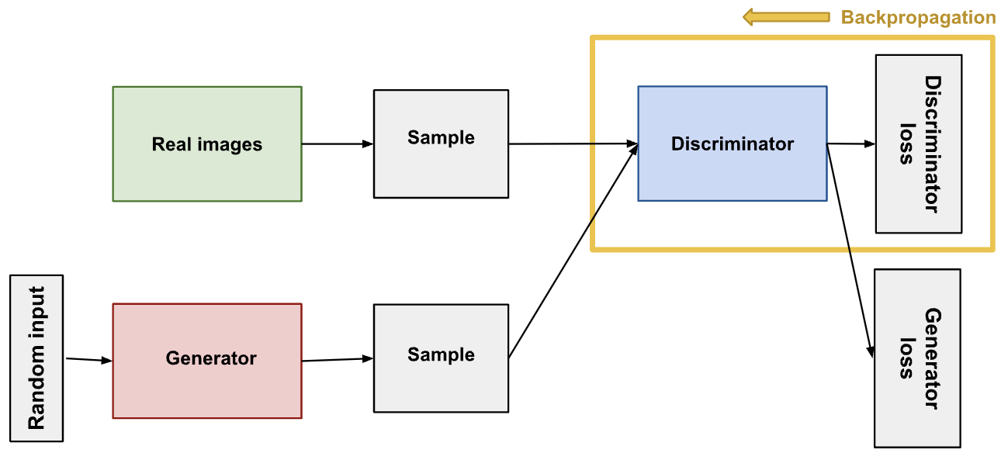
Self-Supervised Learning
GAN
Finally, if generator training goes well, the discriminator gets worse at telling the difference between real and fake. It starts to classify fake data as real, and its accuracy decreases.
The discriminator connects to two loss functions. During discriminator training, the discriminator ignores the generator loss and just uses the discriminator loss. We use the generator loss during generator training

Slide 20
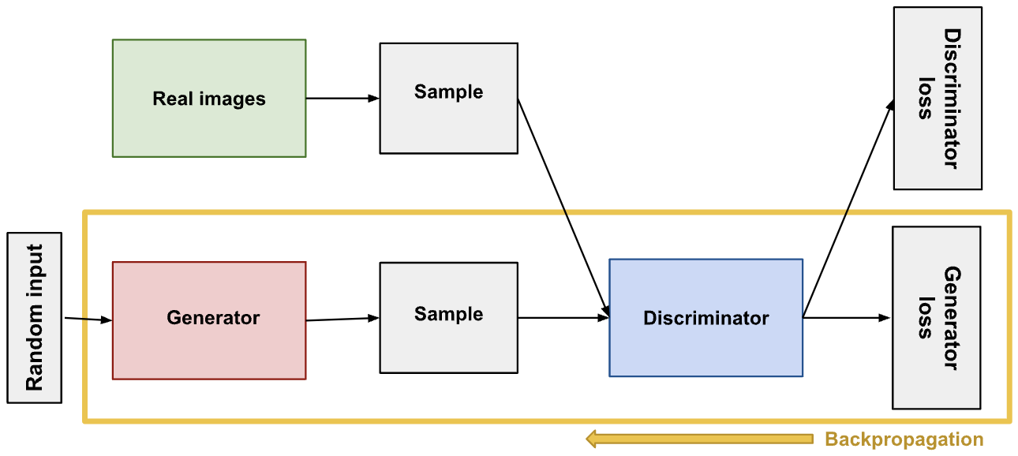
Self-Supervised Learning
GAN

Slide 21
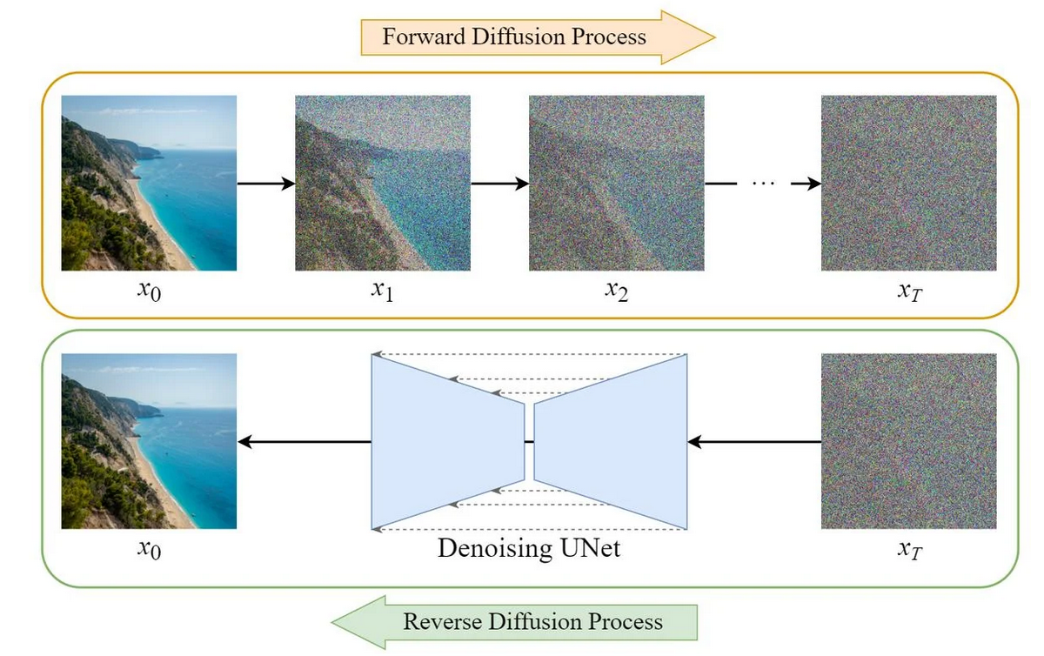
Self-Supervised Learning
Diffusion Models: a type of generative model that learns to generate data by progressively denoising a sample from pure noise.
Goal: To learn a stepwise denoising process that transforms random noise back into meaningful data (e.g., an image).
https://codoraven.com/blog/ai/stable-diffusion-clearly-explained/

Slide 22
Self-Supervised Learning
Main Steps in a Diffusion Model:
Forward Diffusion Process:
Gradually adds Gaussian noise to a data sample over T time steps.
After sufficient steps, the data becomes pure Gaussian noise.

Slide 23
Self-Supervised Learning
Main Steps in a Diffusion Model:
2. Reverse Diffusion Process:
A neural network is trained to predict and remove noise at each step.
The process gradually reconstructs the original data from noise.

Slide 24
Self-Supervised Learning
Diffusion Models vs. GAN
Advantages:
More stable training than GANs
Diffusion models outperform GANs in terms of fidelity and diversity.
Limitations:
Slow inference (requires many denoising steps).
Computationally expensive (high training cost).
https://codoraven.com/blog/ai/stable-diffusion-clearly-explained/

Slide 25
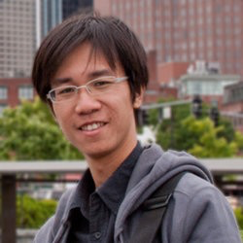
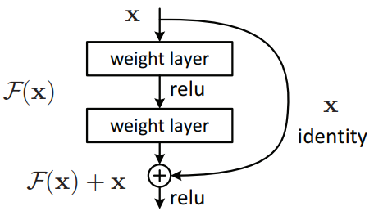
Supervised Learning
ResNet
ResNet (Residual Neural Network) is a deep convolutional neural network (CNN) introduced by Kaiming He in the paper "Deep Residual Learning for Image Recognition".
Why Resnet?
Before ResNet, deep networks like VGG-16 or VGG-19 suffered from:
Vanishing gradients → Gradients shrink as they backpropagate, making learning difficult.
Degradation problem → Deep networks (e.g., 50+ layers) perform worse than shallow ones due to training difficulty.
This architecture introduced the concept called Residual Blocks. In this network, we use a technique called skip connections.

Slide 26
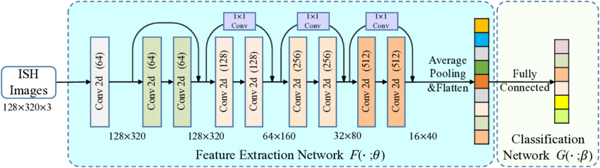
Supervised Learning
ResNet
Why helpful?
The advantage of adding this type of skip connection is that if any layer hurt the performance of architecture then it will be skipped by regularization. So, this results in training a very deep neural network without the problems caused by vanishing/exploding gradient.

Slide 27

Supervised Learning
"Attention Is All You Need."
Transformer
It is the foundation of modern NLP models like BERT, GPT, and T5.

Slide 28
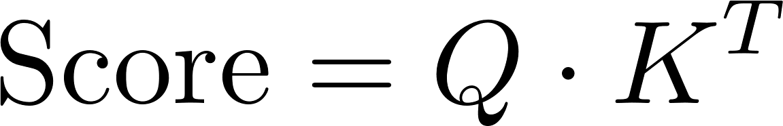
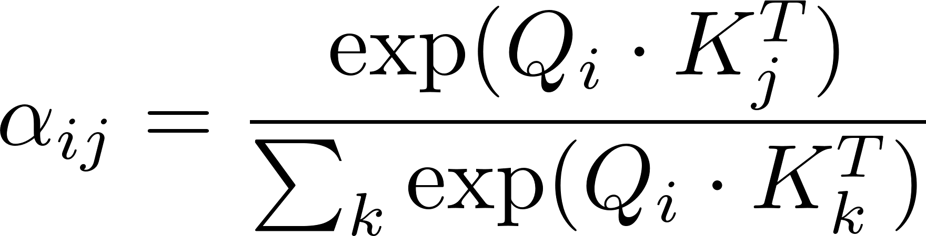
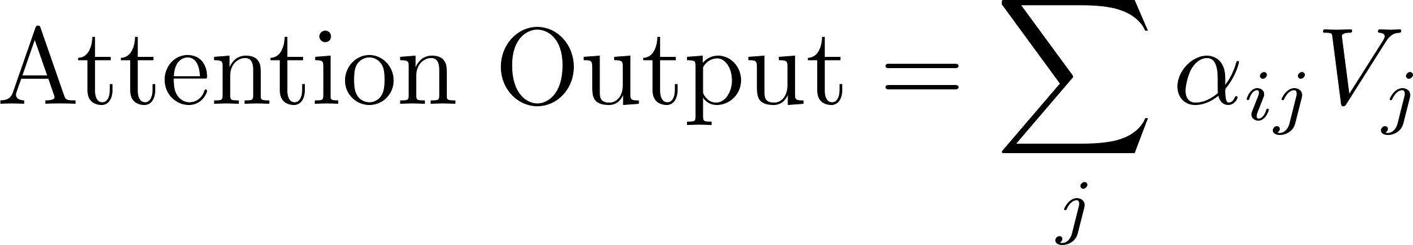
Supervised Learning
Transformer
"Attention Is All You Need."
Why Self-Attention?
Traditional RNNs and LSTMs process sequences sequentially, which Prevents parallelization (slow training).
Forgets long-term dependencies.
Each word in the input sequence is transformed into Query (Q), Key (K), and Value (V) vectors:
1️⃣ Compute attention scores between words using dot-product attention:
2️⃣ Normalize the scores using Softmax:
3️⃣ Compute weighted sum of Values (V):

Slide 29
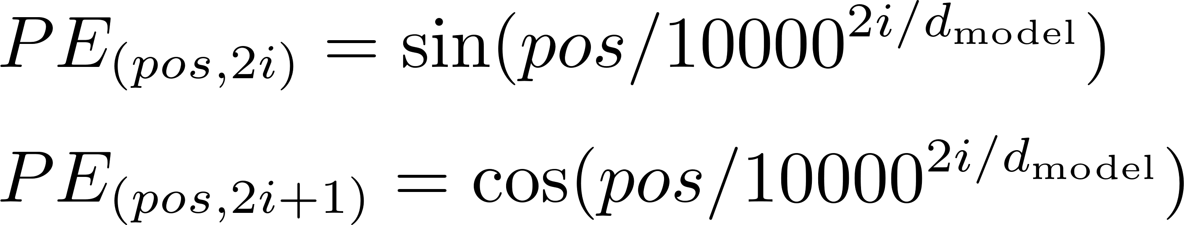
Supervised Learning
"Attention Is All You Need."
Transformer
multiple attention heads to capture different types of relationships
Unlike RNNs, Transformers do not process tokens sequentially. To retain word order information, we add positional encodings

Slide 30
Supervised Learning
"Attention Is All You Need."
Transformer
Each attention block is followed by a **position-wise feedforward network
Notes:
W_1, W_2 are learned weights.
The ReLU activation function adds non-linearity.

Slide 31
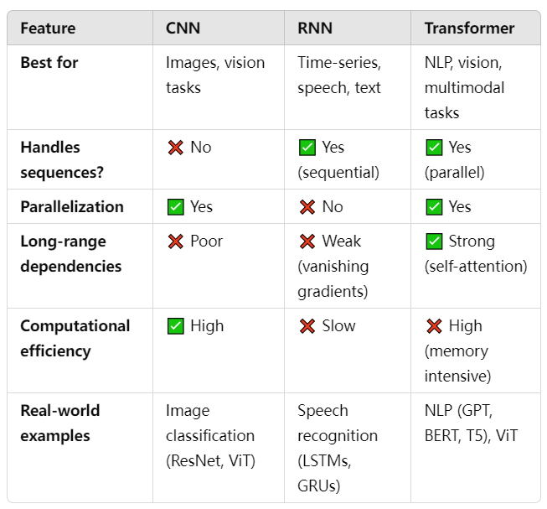
Supervised Learning
CNN vs. RNN vs. Transformer
Notes:
Vanishing Gradient Problem → Gradients shrink over long sequences.

Slide 32
Thanks

